Slide 1
California Indian Law Association Conference Graton Resort and Casino October 4, 2019 Indian Child Welfare Act Delia M. Sharpe, Executive Director Kimberly Cluff, In-House Counsel Morongo Band of Mission Indians California Tribal Families Coalition

Slide 2
The 2017 ICWA Compliance Task Force Report identified ICWA violations which emerged most frequently...
Lack of funding
Lack of pre-removal remedial services and robust active reunification efforts
Failure to complete diligent inquiry & notice
Resistance to tribal court jurisdiction
Barriers to tribal participation in court processes
Lack of competency within court systems
Deviation from or violation of placement preferences
Notes:
CTFC is a successor organization to the ICWA Compliance Task Force… with a BIG mission and a lot of work ahead.

Slide 3
Initial roadmap for our work has been to push for the implementation of the recommendations contained in the 2017 ICWA Compliance Task Force Report.
Notes:
Meetings with state agencies, legislation

Slide 4
2018 ICWA Legislation
AB 3176 (Waldron)
AB 3047 (Daly)
AB 3076 (Reyes)

Slide 5
What is AB 3176?
Tribally-sponsored bill, reflecting a collaborative effort with state and county partners
Amends 32 sections of the California Welfare and Institutions Code
State law update incorporating the 2016 BIA ICWA regulations into California law
2016 BIA ICWA regulations were effective December 2016
AB 3176 was effective January 1, 2019
Notes:
How much legislative support there was for 3176 – a lot of authors. CTFC actively engaged. Tried as hard as we could to stay within the focus of the 2016 ICWA regulations.

Slide 6
AB 3047 (Daly)
Provides a fee waiver for out-of-state tribal attorneys using California's pro hac vice process to ensure tribes are rightfully represented in ICWA cases.

Slide 7
AB 3076 (Reyes)
Legal counsel for tribes in ICWA cases
Now… AB 685

Slide 8
2019 ICWA Legislation
AB 685 (Reyes)
AB 686 (Waldron)
Tribal Youth Diversion Funding

Slide 9
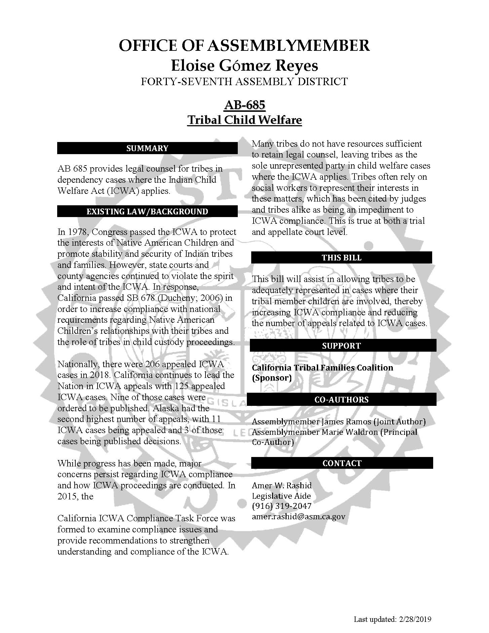

Slide 10
AB 686 (Waldron)
Seeks to increases ICWA compliance by:
clarifying placement approval standards for Indian children.
2. ensuring that Indian tribes can fully participate in ICWA cases by ensuring access to telephonic or other computerized or electronic remote access options for court appearances, at no cost.

Slide 11
ICWA Bill Authors
James Ramos (San Manuel), joint author
Eloise Reyes, principal co-author
Marie Waldron, principal co-author

Slide 12
Tribal Youth Diversion Program
$10 million dollars to keep tribal youth across the state out of the juvenile justice system
Last year only $1 million was funded to cover about $8 million in tribal grant application
Goal is to fund all 2019 applications and ask for additional funds next year

Slide 13
2019-2010 Priority Setting
California ICWA Compliance Task Force Report:
[A]s we near the 40th anniversary of the ICWA, we must hold ourselves to a higher standard so we do not look back on only incremental progress, but look forward to achieve the articulated national and state policies to protect Indian children and preserve Indian tribes through compliance with this landmark legislation.

Slide 14
Looking forward…
Collaborative solutions
Legislative solutions
Tribal infrastructure development
Complaints to the California Attorney General’s Office

Slide 15
State – Tribal Agreement
A statewide ICWA agreement negotiated with tribes who express interest that addresses the specific issues, related to Indian child welfare, that are identified by tribes.

Slide 16
State – Tribal Agreement
Legal counsel for tribes in ICWA cases
-Tribal Title IV-E Reimbursement
- Federal Child Welfare Manual Guidance

Slide 17
State – Tribal Agreement
Are title IV-E administrative costs for the legal representation provided by agency attorneys and for independent legal representation of children and parents in all stages of foster care related legal proceedings available to tribes and public agencies that have an agreement under section 472(a)(2)(B)(ii) of the Act?

Slide 18
State – Tribal Agreement
Yes. A title IV-E agency that has an agreement with a tribe or any other public agency under section 472(a)(2)(B)(ii) of the Act may claim title IV-E administrative costs for legal representation provided by tribal or public agency attorneys under the agreement in all stages of foster care related legal proceedings. The title IV-E agency may also claim administrative costs for independent legal representation provided by an attorney for a candidate for title IV-E foster care or a title IV-E eligible child in foster care who is served under the agreement, and the child’s parents, to prepare for and participate in all stages of foster care related legal proceedings.

Slide 19
Strategy
Cutting edge work
Will require tribal leadership commitment
Tribal leader negotiation
Tribal lobbyist effort
Subject matter experts

Slide 20
Appellate Project Work
Support tribes in ICWA appeals
File amicus briefs in select cases
Encourage appeals to California Supreme Court where appropriate
Rather than just requesting depublication of bad cases

Slide 21
2020 Legislative Ideas
Clarify Tribal Customary Adoption and Resource Family Approval connection
Mandate foster family training that is consistent with tribal social and cultural standards
Would seek to shift funding from CA community colleges to Tribes/Tribal organizations to develop trainings that are offered online or through tribal SS Department.
Clarify how Child and Family Teaming occurs where a case involves an Indian child

Slide 22
Tribal Funding
Funding
Title IV-E Direct agreements
Title IV-E State agreement
Contracts with the state (or county) for services provided to Indian children under the jurisdiction of the state child welfare system.
Medicaid billing
Tribal Justice Systems - BIA funding to develop tribal court infrastructure

Slide 23
2017 ICWA Compliance Task Force Report
To achieve the promise of the ICWA, there must be more than episodic rallying cries and well-meaning grant cycle initiatives; there must be a vigilant force that demands more than mere lip service to compliance.
… the task at hand is large

Slide 24
Thank you!

