Slide 1
AB 52: Putting the Tribe in Tribal Cultural Resources
Michele Hannah, Deputy General Counsel
Pechanga Indian Reservation
CILA Conference, October 14, 2016

Slide 2
Today’s Objectives
What: To demonstrate the practice of AB 52 and Tribal Cultural Resource Protection
How: Discuss the key provisions of the law, but with a focus on how they work in the real world of Tribal Cultural Resources Protection
Why: To train the next generation of Tribal Cultural Resource protectionists

Slide 3
AB 52 v. “Old School” CEQA
For most of our experience under CEQA, tribes were treated as members of the public
Tribal information/expertise was disregarded or ignored
CEQA focuses on “archaeological” resources as cultural resources
Things in the dirt
Things you can touch – the tangible
Thus, the environmental impacts were focuses on the scientific value of the resource
With AB 52, we have entered into a new world
Tribes are recognized as governments
Tribal expertise is acknowledged
Tribal values must be considered

Slide 4
What is a Tribal Cultural Resource?
Sites, features, places, cultural landscapes, sacred places, and objects with cultural value to a California Native American Tribe (PRC §21074(a))
Included or eligible for inclusion on the California Register of Historic Places
Included in a local register
“Discretionary” – as determined by a lead agency, supported by substantial evidence
Keep in mind that even without a TCR, there may still be cultural or archaeological resources that must be addressed

Slide 5
Eligibility Criteria (14 C.C.R. §4852(b))
Criterion 1: Associated with events that have made a significant contribution to the broad patterns of local or regional history or the cultural heritage of California or the United States.
Criterion 2: Associated with the lives of persons important to local, California or national history.
Criterion 3: Embodies the distinctive characteristic of a type, period, region or method of construction or represents the work of a master or possessed high artistic values.
Criterion 4: Has yielded or has the potential to yield, information important to the prehistory or history of the local area, California or the nation.

Slide 6
Tribal Values
AB 52 finally gives a voice to the values that tribes place on their resources
These values are inherent to the tribal community which holds such cultural value
Long-standing clash between archaeologists and tribes on the value of cultural resources
Archaeologists are first, not usually tribal people, and second, are focused on the scientific value of a resource
Tribes view these resources – both the tangible and intangible – as having inherent cultural value, which is part and parcel of their identity as native peoples and their cultural heritage
With AB 52, there is an on-going struggle to not just accept the new reality of CEQA, but also of how to gather and address these cultural values

Slide 7
Traditional Cultural Places/Landscapes
Federal law acknowledges “traditional cultural properties” or TCPs
“…TCPs, by definition, are those places regarded as significant by the community involved. The strength of a property’s being designated a TCP rests finally on the community’s understanding of [Native American] cosmology, as to what would be regarded as significant.” See N.P.S. Bulletin 38
AB 52 references “traditional cultural landscapes”
Must have cultural value to a California Native American Tribe
Must be defined in terms of size and scope

Slide 8
Traditional Cultural Properties and Landscapes Káamalam Pómki/Pu’eska Mountain

Slide 9
Traditional Cultural Properties and Landscapes ‘éxva Teméeku

Slide 10
What Criteria Apply?
Criterion 1: Associated with events that have made a significant contribution to the broad patterns of local or regional history or the cultural heritage of California or the United States.
Criterion 2: Associated with the lives of persons important to local, California or national history.
Criterion 3: Embodies the distinctive characteristic of a type, period, region or method of construction or represents the work of a master or possessed high artistic values.
Criterion 4: Has yielded or has the potential to yield, information important to the prehistory or history of the local area, California or the nation.

Slide 11
Traditional Cultural Properties and Landscapes Chéexayam Pum’wappivu & ‘Anó’ Pótma

Slide 12
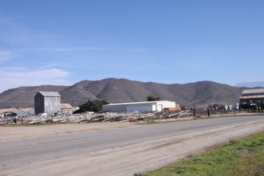
Traditional Cultural Properties and Landscapes Chéexayam Pum’wappivu & ‘Anó’ Pótma

Slide 13
What Criteria Apply?
Criterion 1: Associated with events that have made a significant contribution to the broad patterns of local or regional history or the cultural heritage of California or the United States.
Criterion 2: Associated with the lives of persons important to local, California or national history.
Criterion 3: Embodies the distinctive characteristic of a type, period, region or method of construction or represents the work of a master or possessed high artistic values.
Criterion 4: Has yielded or has the potential to yield, information important to the prehistory or history of the local area, California or the nation.

Slide 14
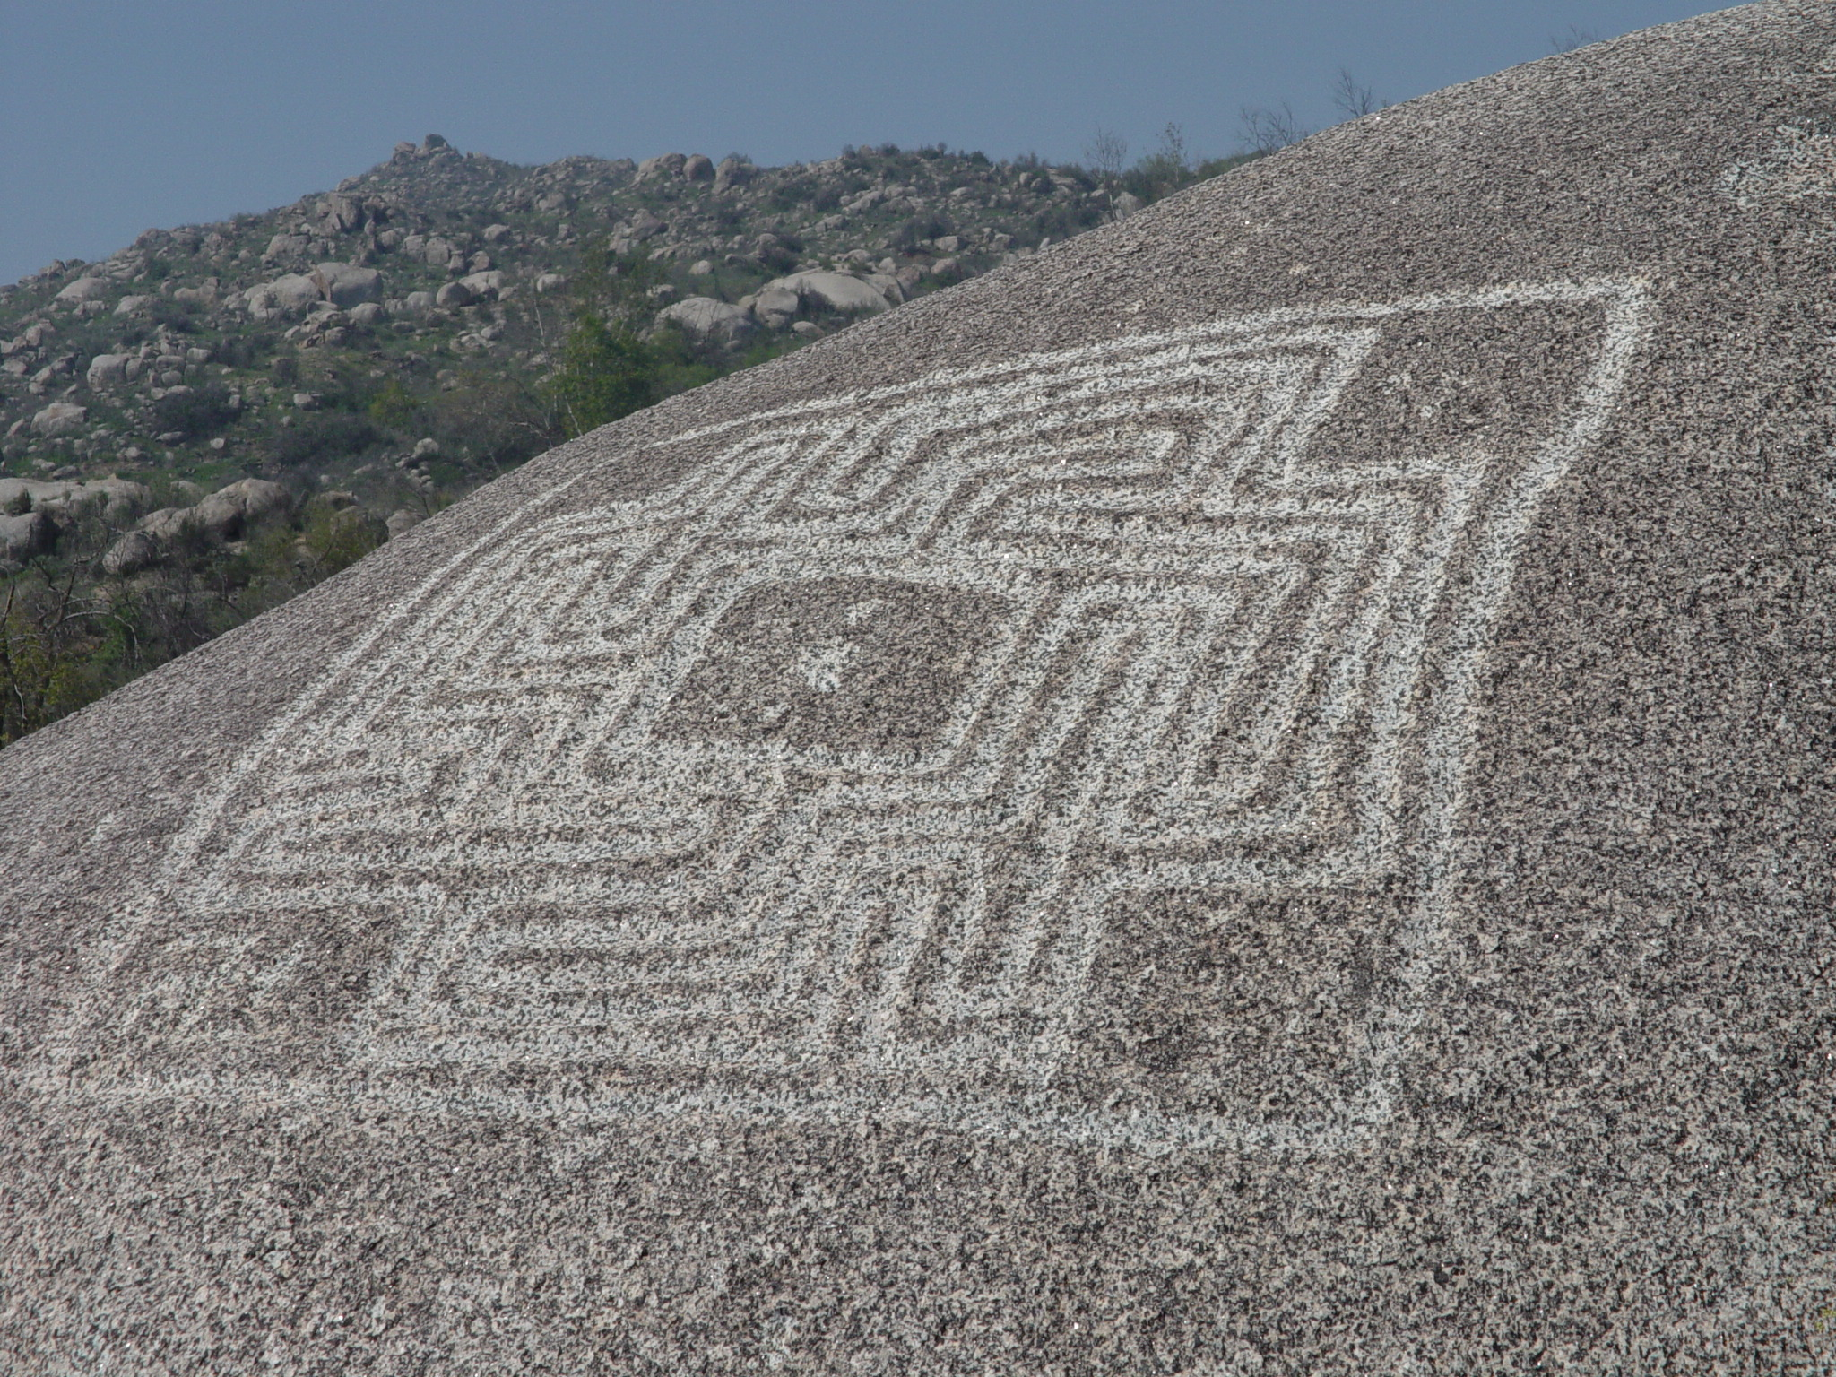
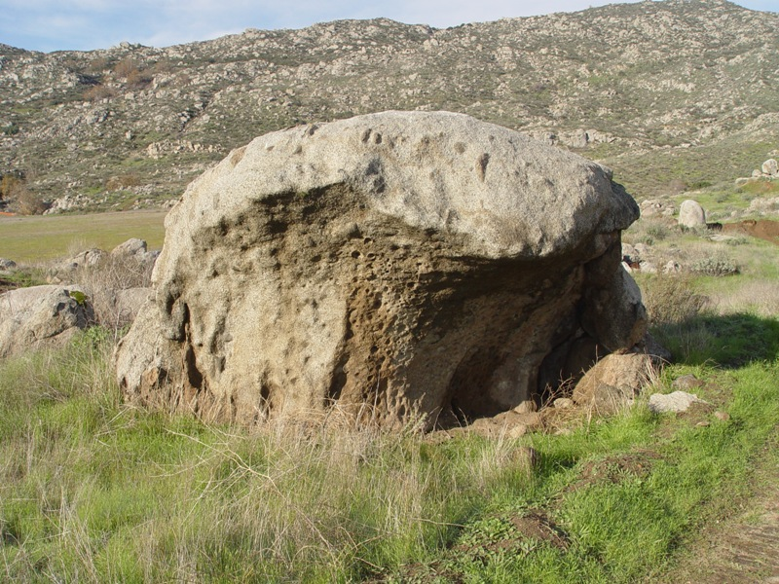
Sacred Places and Features

Slide 15
What Criteria Apply?
Criterion 1: Associated with events that have made a significant contribution to the broad patterns of local or regional history or the cultural heritage of California or the United States.
Criterion 2: Associated with the lives of persons important to local, California or national history.
Criterion 3: Embodies the distinctive characteristic of a type, period, region or method of construction or represents the work of a master or possessed high artistic values.
Criterion 4: Has yielded or has the potential to yield, information important to the prehistory or history of the local area, California or the nation.

Slide 16
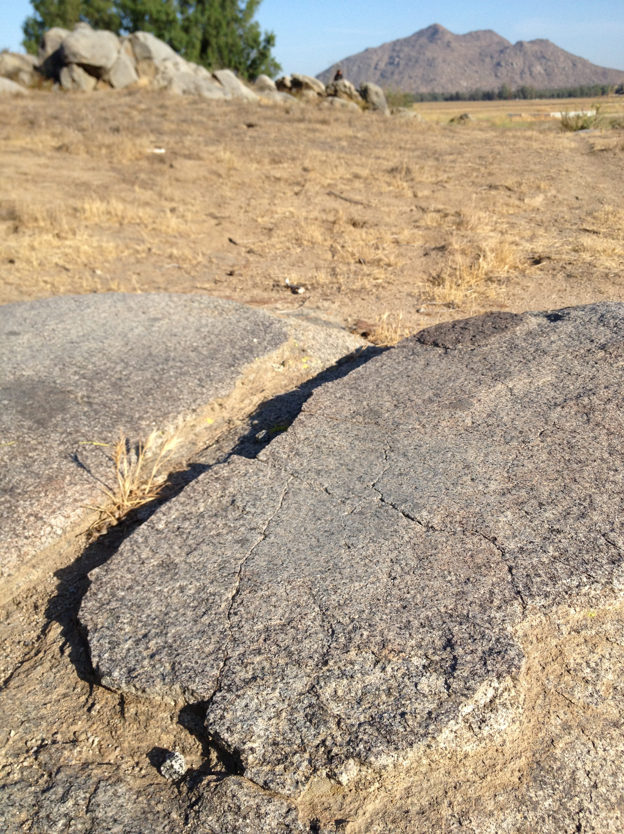
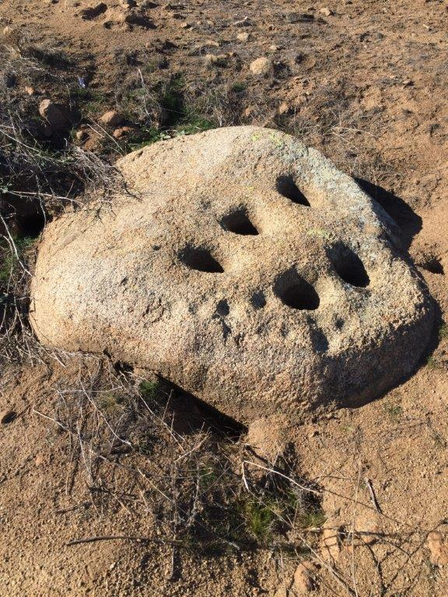
Objects with Cultural Value

Slide 17
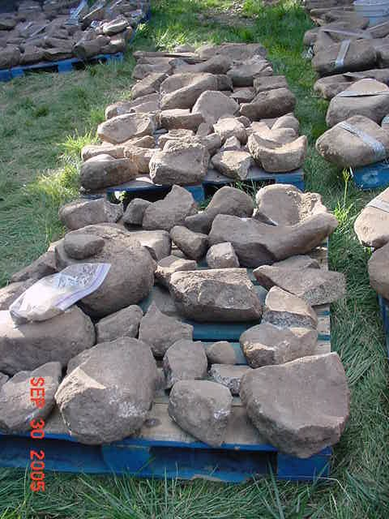
Objects with Cultural Value

Slide 18
What Criteria Apply?
Criterion 1: Associated with events that have made a significant contribution to the broad patterns of local or regional history or the cultural heritage of California or the United States.
Criterion 2: Associated with the lives of persons important to local, California or national history.
Criterion 3: Embodies the distinctive characteristic of a type, period, region or method of construction or represents the work of a master or possessed high artistic values.
Criterion 4: Has yielded or has the potential to yield, information important to the prehistory or history of the local area, California or the nation.

Slide 19
Consultation
Consultation means the “meaningful and timely process of seeking, discussing, and considering carefully the views of others, in a manner that is cognizant of all parties’ cultural values and, where feasible, seeking agreement. Consultation between government agencies and Native American tribes shall be conducted in a way that is mutually respectful for each party’s sovereignty.” (Government Code §65352.4)

Slide 20
Consultation under AB 52
“Within 14 days of deeming an application complete”
Tribe must respond within 30 days, requesting consultation
Agency has 30 days to initiate such consultation
What we call the 14-30-30 timeline
Consultation must occur prior to release of a negative declaration, mitigated negative declaration or and environmental impact report

Slide 21
Consultation Topics
Level of environmental review (PRC §§21080.3.1(b) and 21080.3.2(a))
A project with an effect that may cause a substantial adverse change in the significance of a tribal cultural resource is a project that may have a significant effect on the environment (PRC §21084.2)
It is imperative that a lead agency consult with a tribe prior to determining and certainly before preparing their environmental document because the analysis of TCRs on the project is an absolutely necessary first step
Presence and significance of Tribal Cultural Resources and impacts of project thereto (PRC §21080.3.2)
Avoidance and/or mitigation measures (PRC §21080.3.2 and 21084.3)

Slide 22
The End of Consultation
PRC §21080.3.2(b))
The parties agree to measures that mitigate or avoid a significant effect on a TCR
A party, acting in good faith and after reasonable effort, concludes that mutual agreement cannot be reached
Consultation must continue through final approval as changes are made at the planning and final decision-making level

Slide 23
Consultation Contemplation
A few issues with consultation
The “box-checking” factor
Lack of guidance/framework
In absence of state guidance, tribal protocols with lead agencies?
New agencies to the mix: water and school districts, utilities
Tribal Values
Planners are not equipped to understand this aspect
Staff and consultant archaeologists are archaeologists!

Slide 24
Confidentiality
During Consultation (PRC §21082.3(c)(2)(A))
Any information that a tribe shares regarding the location, description and use of TCRs
Information we share with the lead agency or the applicant
For the first time, the applicant is subject to confidentiality, “using a reasonable degree of care” and may not share information regarding TCRs with third parties
Confidentiality is for the purpose of preventing looting, vandalism, or damage to tribal cultural resources

Slide 25
Confidentiality
In the environmental document (PRC §21082.3(c)(1))
Must provide sufficient information for decision-makers, but law requires prior consent of the tribe and if any confidential information is published, it must go into a confidential appendix, unless the tribe agrees in writing
AB 52 “does not prevent a lead agency or other public agency from describing the information in general terms in the environmental document so as to inform the public of the basis of the lead agency’s or other public agency’s decision without breaching confidentiality…” (PRC §21082.3(c)(3))
How is tribal information packaged for the environmental document?
What is tribal information? Who writes it? How much goes into the actual document versus a confidential appendix?

Slide 26
Avoidance of Impacts
Public agencies shall, when feasible, avoid damaging effects to any TCR (PRC §21084.3(a))
What are avoidance options?
Redesign – why it is so important to consult early
Planning options (i.e., parking variances)
Preservation in open space/park/conservation
The carrot: donations to tribes in both conservation and fee are charitable contributions, which means the applicant can recoup some of their losses

Slide 27
Mitigation of Impacts
PRC §21084.3(b)(2))
Treating the resource with appropriate dignity, including the tribal cultural values and meaning of the resource
Protecting the cultural character and integrity of the resource
Protecting the traditional use of the resource
Protecting the confidentiality of the resource
Permanent conservation easements or other interests in real property with culturally appropriate management criteria
Protecting the resource

Slide 28
How to Protect via Mitigation?
Avoidance of impacts, with long-term preservation
May include active/passive park use, with signage and trails
Sensitive and thoughtful conditions on construction – the Calendar Rock example
Ethnographic and landscapes studies
Relocation of resources – less preferred, but better than destruction
Inadvertent discoveries protection, including open space for relocation/reburial of items
Controlled grading – best when there is a potential for subsurface resources that are not known from surface indicators
Tribal monitoring – the last resort

Slide 29
Summary
AB 52 dramatically changes the tribal cultural resource protection, CEQA and land management “landscapes”
Tribes are recognized as governments, with expertise over their cultural heritage
Resources must now be considered from the tribal value perspective
Tribes have stronger ways to ensure TCRs are avoided or impacts thereto mitigated appropriately
A huge learning curve, however, means we have a long way to go!

Slide 30
No∫úun Lόoviq (Thank you)
The End

